Slide 1
Learning Objective
I will be able to graphs of derivative function
Success Criteria
At the end of the lesson, I will be able to:
Recognise graphs of derivative function
Sketch graphs of derivative functions

Slide 2




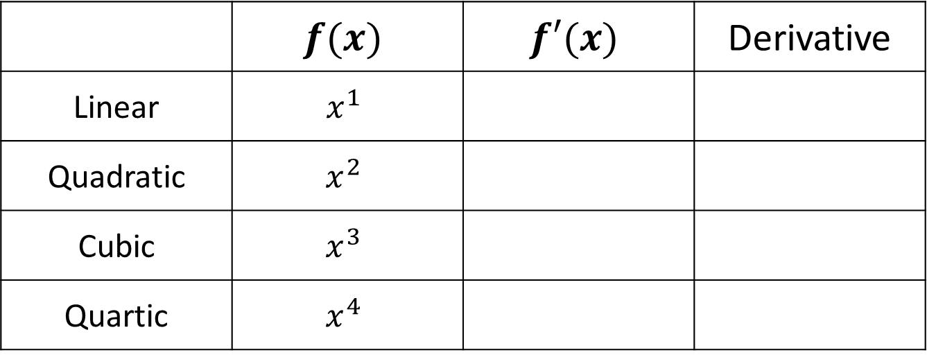
Rules of Derivative
Concept Development
 | $$f(x)$$ | $$f′(x)$$ | Derivative
Linear | $$x^{1}$$
Quadratic | $$x^{2}$$
Cubic | $$x^{3}$$
Quartic | $$x^{4}$$
$$1$$
Constant
$$2x$$
Linear
$$3x^{2}$$
Quadratic
$$4x^{3}$$
Cubic

Slide 3
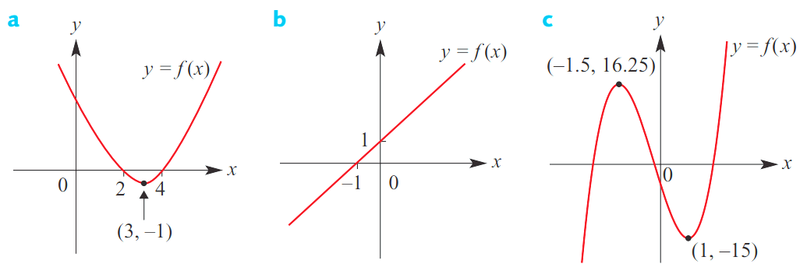



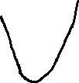
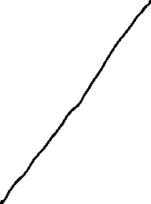
Sketch the graph of $y=f^{′}\left(x\right)$ for each of the following
Guided Practice

Slide 4
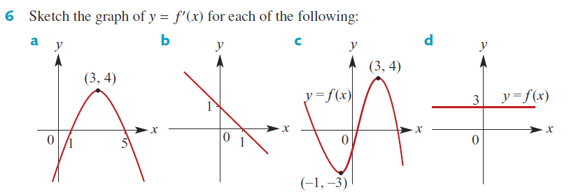



Sketch the graph of $y=f^{′}\left(x\right)$ for each of the following
Guided Practice

Slide 5
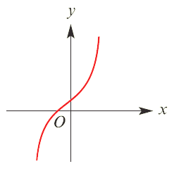
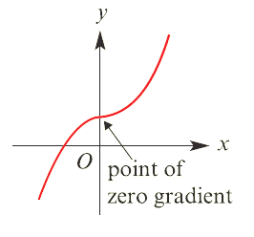



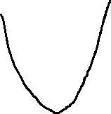

Sketch the graph of $y=f^{′}\left(x\right)$ for each of the following
Guided Practice

Slide 6
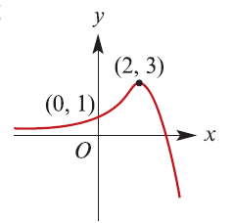
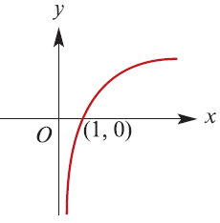

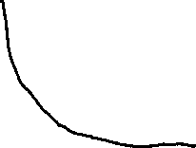

Guided Practice

Slide 7
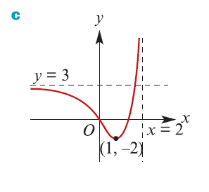
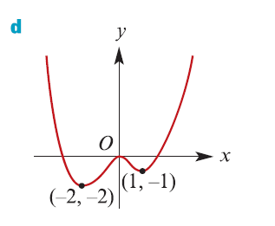
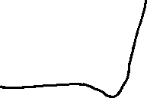
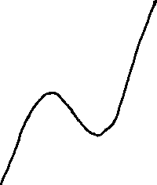
Guided Practice

Slide 8
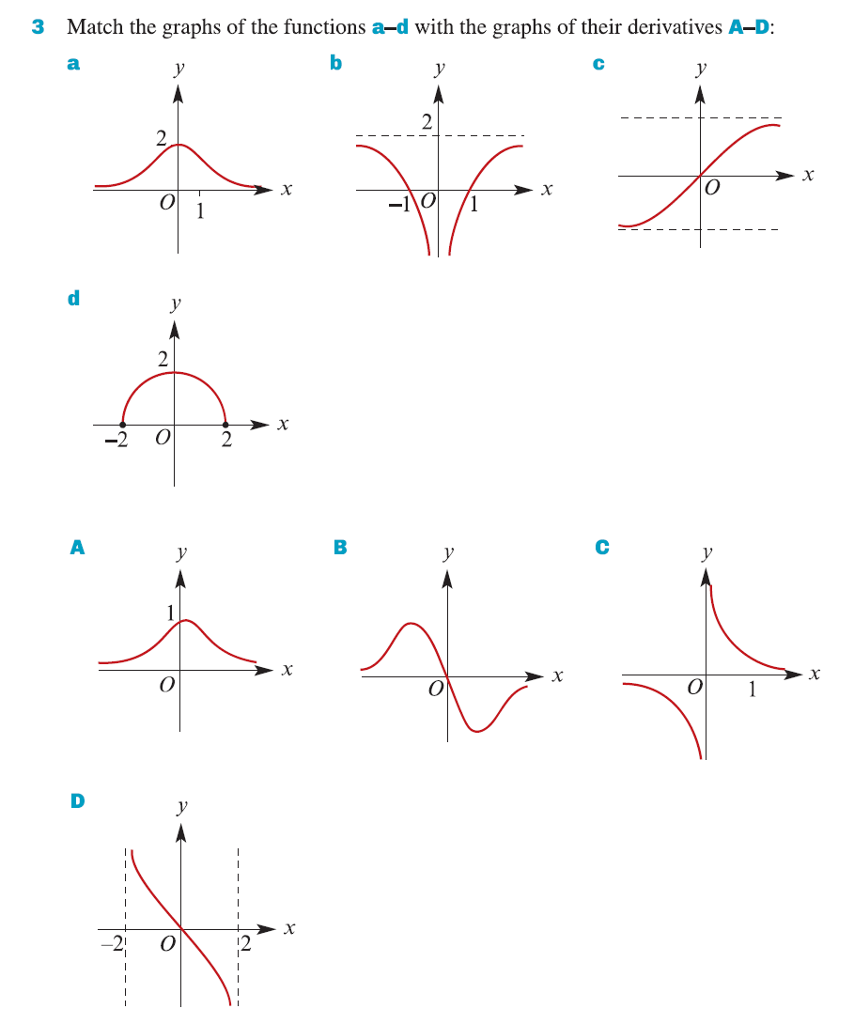






Guided Practice

Slide 9
Independent Practice
Complete Cambridge Ex 4D

